Slide 1

Introduction to Unity
Course DNA
Summary:
Unity quick start, interface tour, the Scene, Project, Hierarchy & Inspector panels, object manipulation, tips.

Slide 2
Unity overview
Unity can create games in 2D or 3D mode with minor differences between how you do this.
You can create games to run on a PC (including Mac), web, Android, iOS, Blackberry, Windows Phone, console (Xbox, PS, Switch etc.), XR, TV amongst others…
Unity has a very intuitive workflow:
operates on a component based model
main UI includes tabs for project, scene view, scene hierarchy, object inspector and console
many tools included for animation, particle systems, materials, audio, performance monitoring, building etc.
simple drag-and-drop interface for scene building, component management etc.
can be enhanced using many free and paid for extensions available directly through the Unity3D website
it's so good, Epic 'borrowed' it for UE4 and changed some of the names…
Unity has a very active and helpful community that provide support, tips, assets and extensions.
V2018 includes Entity Component System, ShaderGraph, 2D toolset, VFX pipeline, Cinemachine
also: Scriptable Render Pipeline, Pro Builder, Package Manager + lots of visual improvements & tweaks!
Provides the free Community Edition of Microsoft Visual Studio 2017 as an IDE.
Also, 2019 version makes installing Android SDK a breeze…

Slide 3

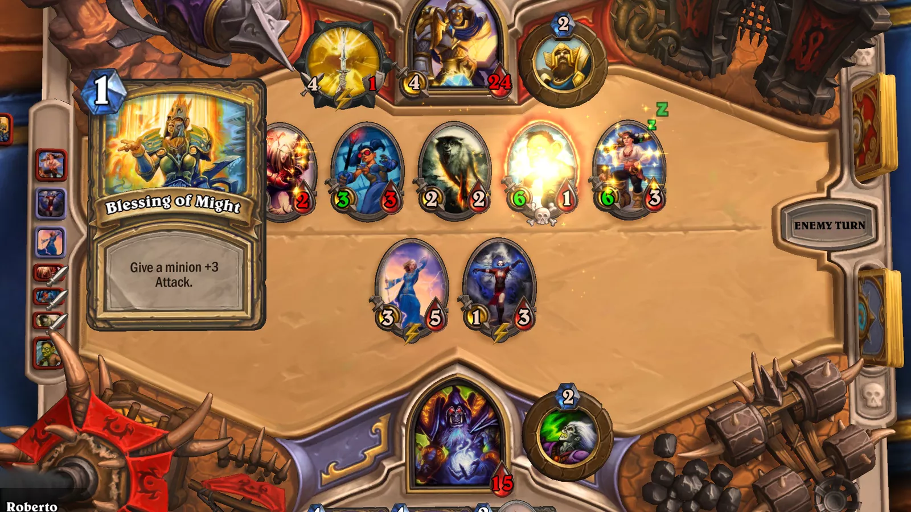
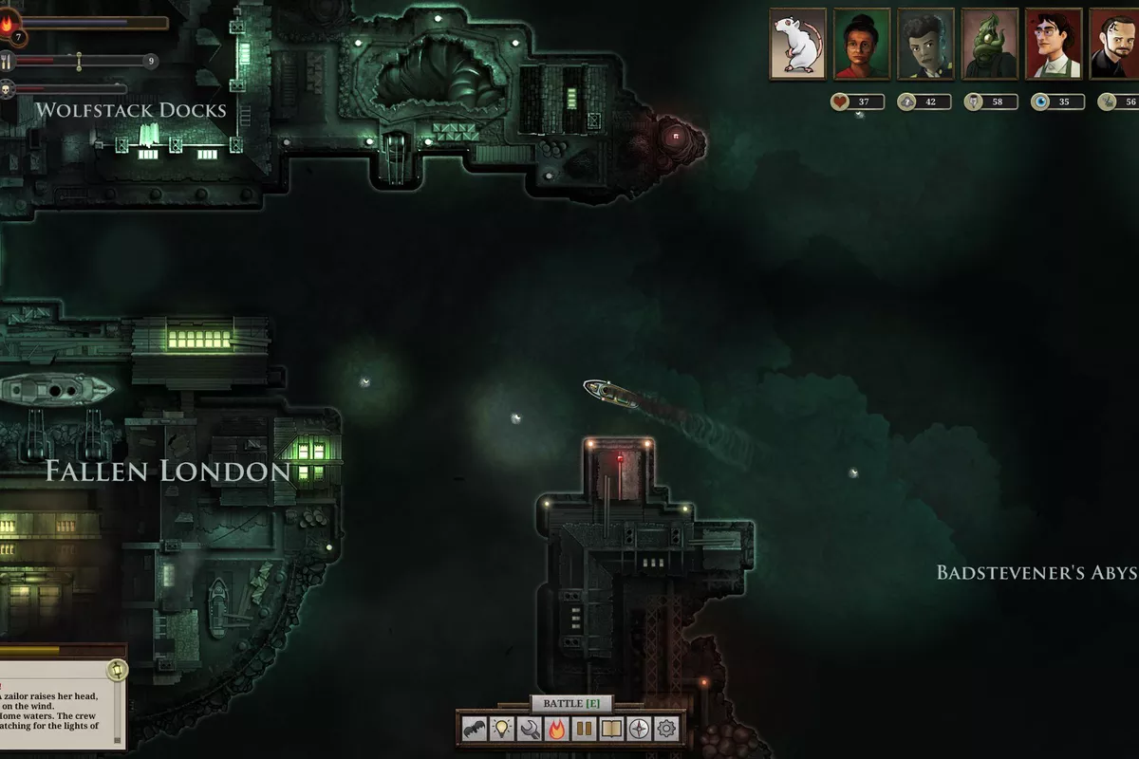
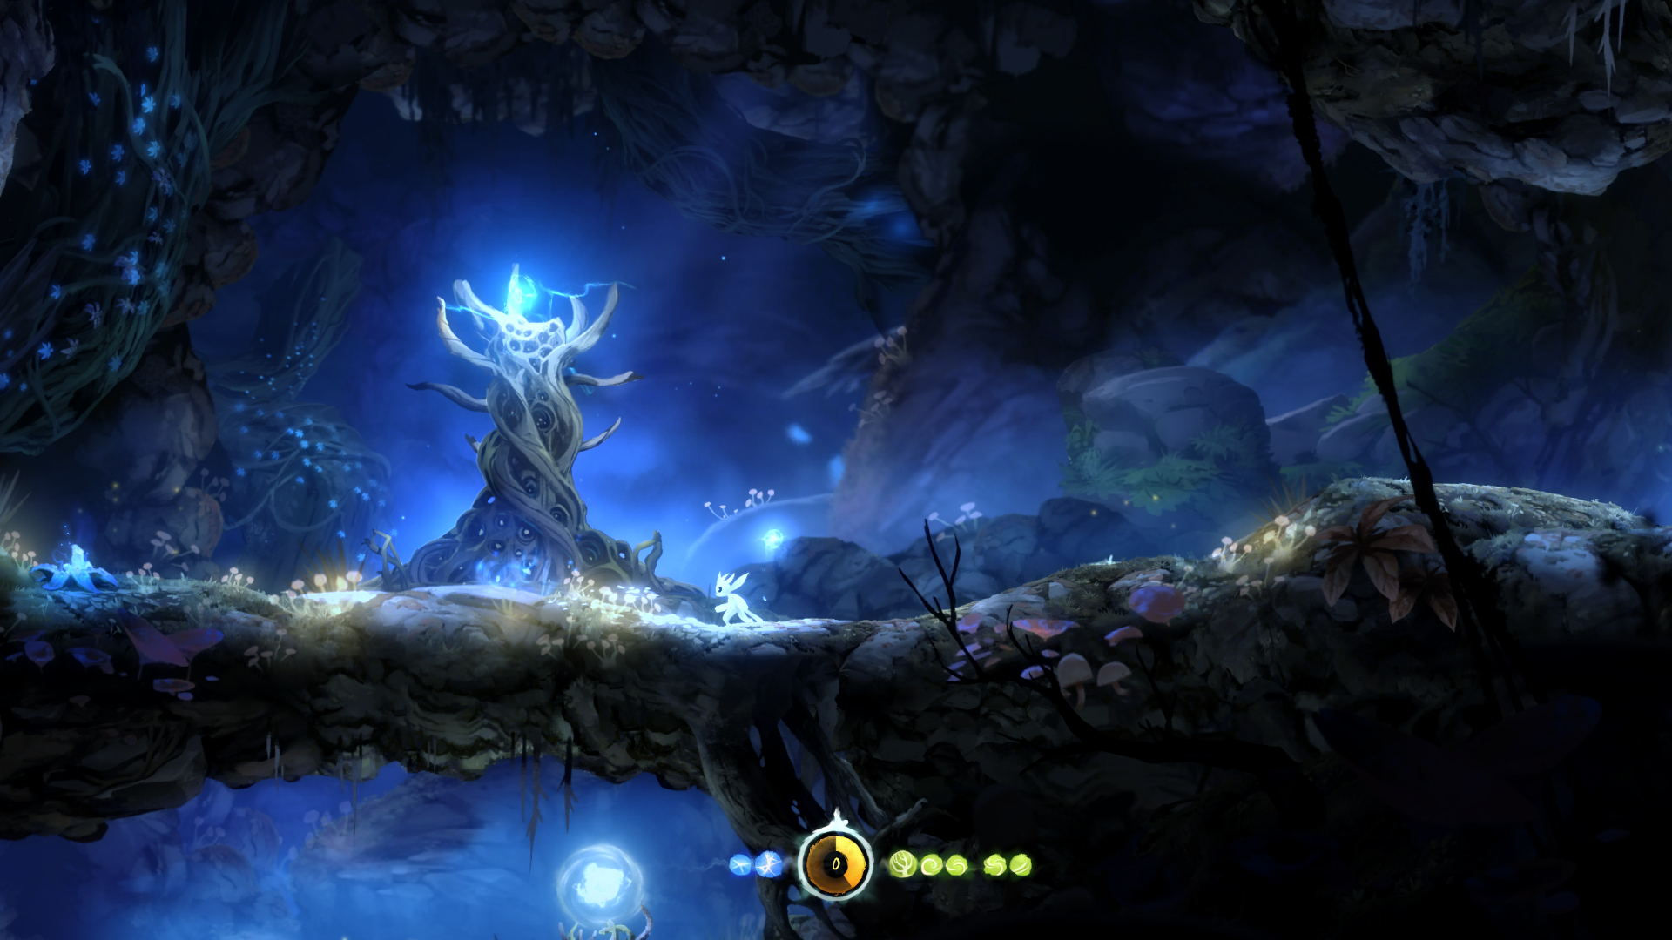
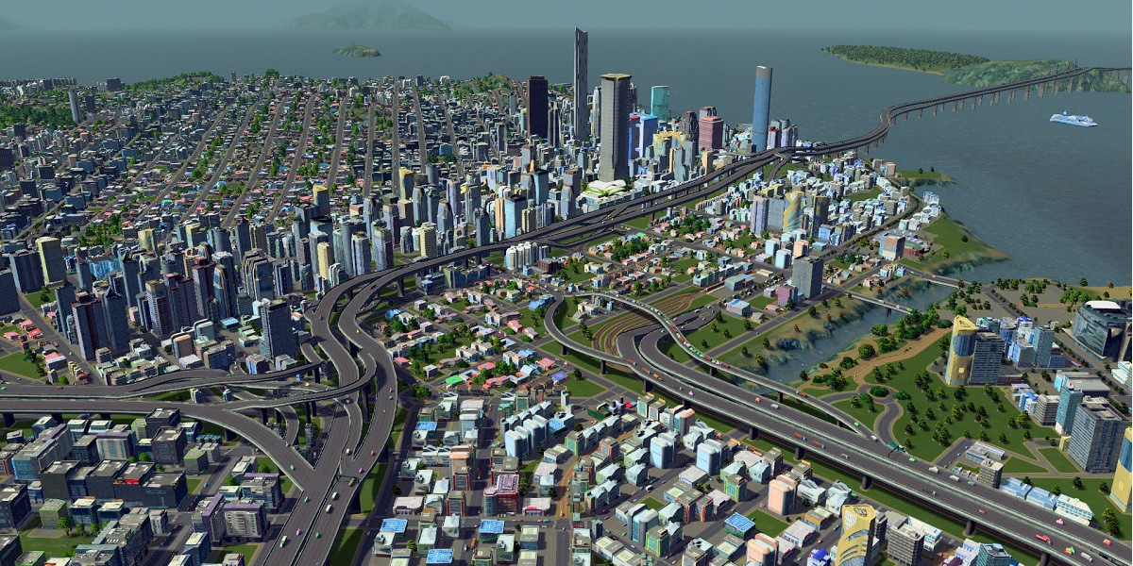
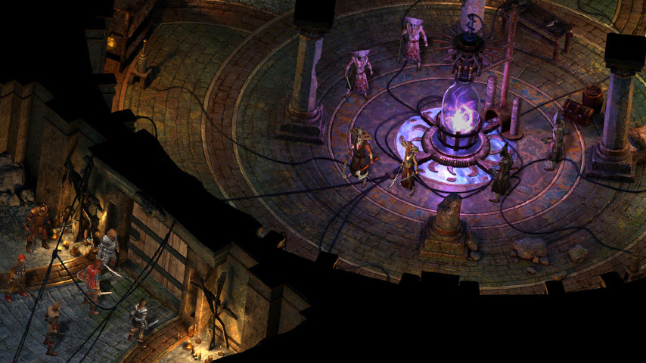


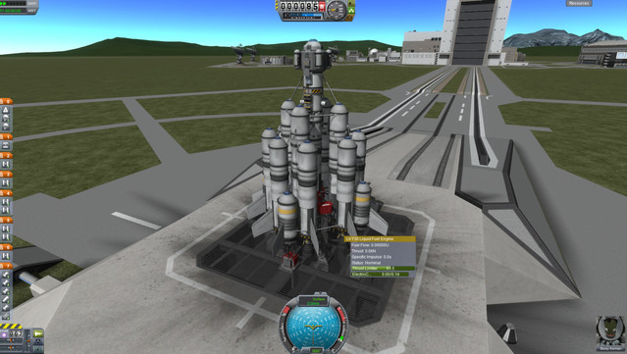
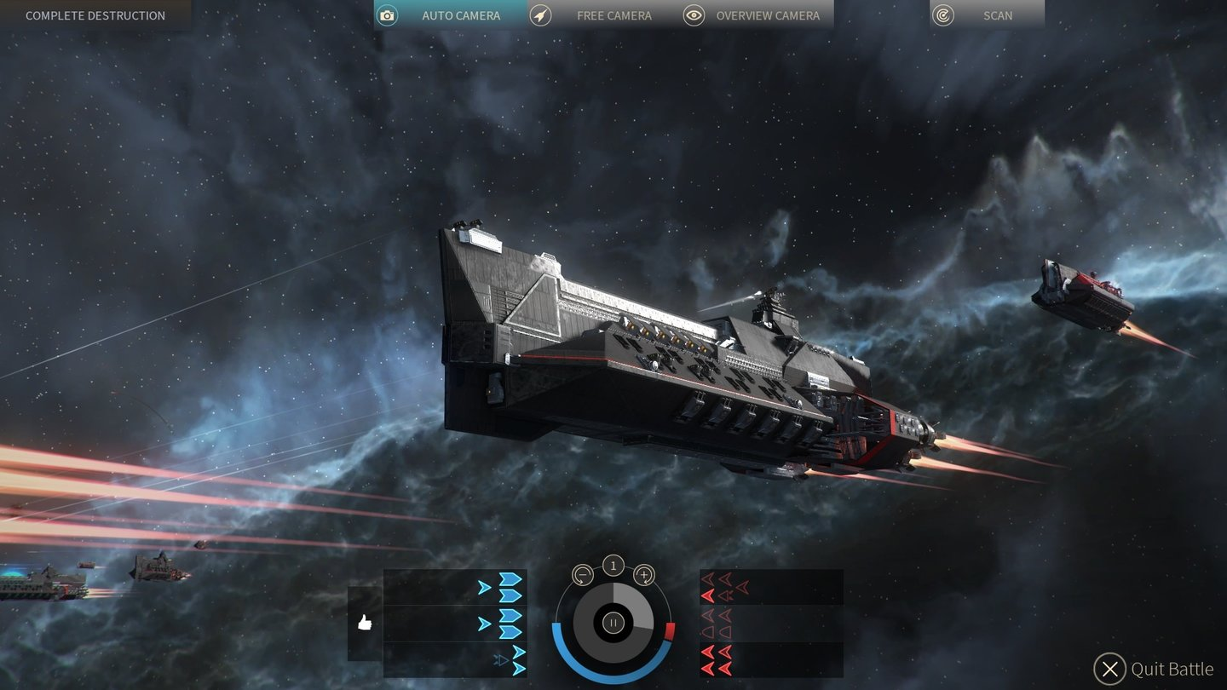
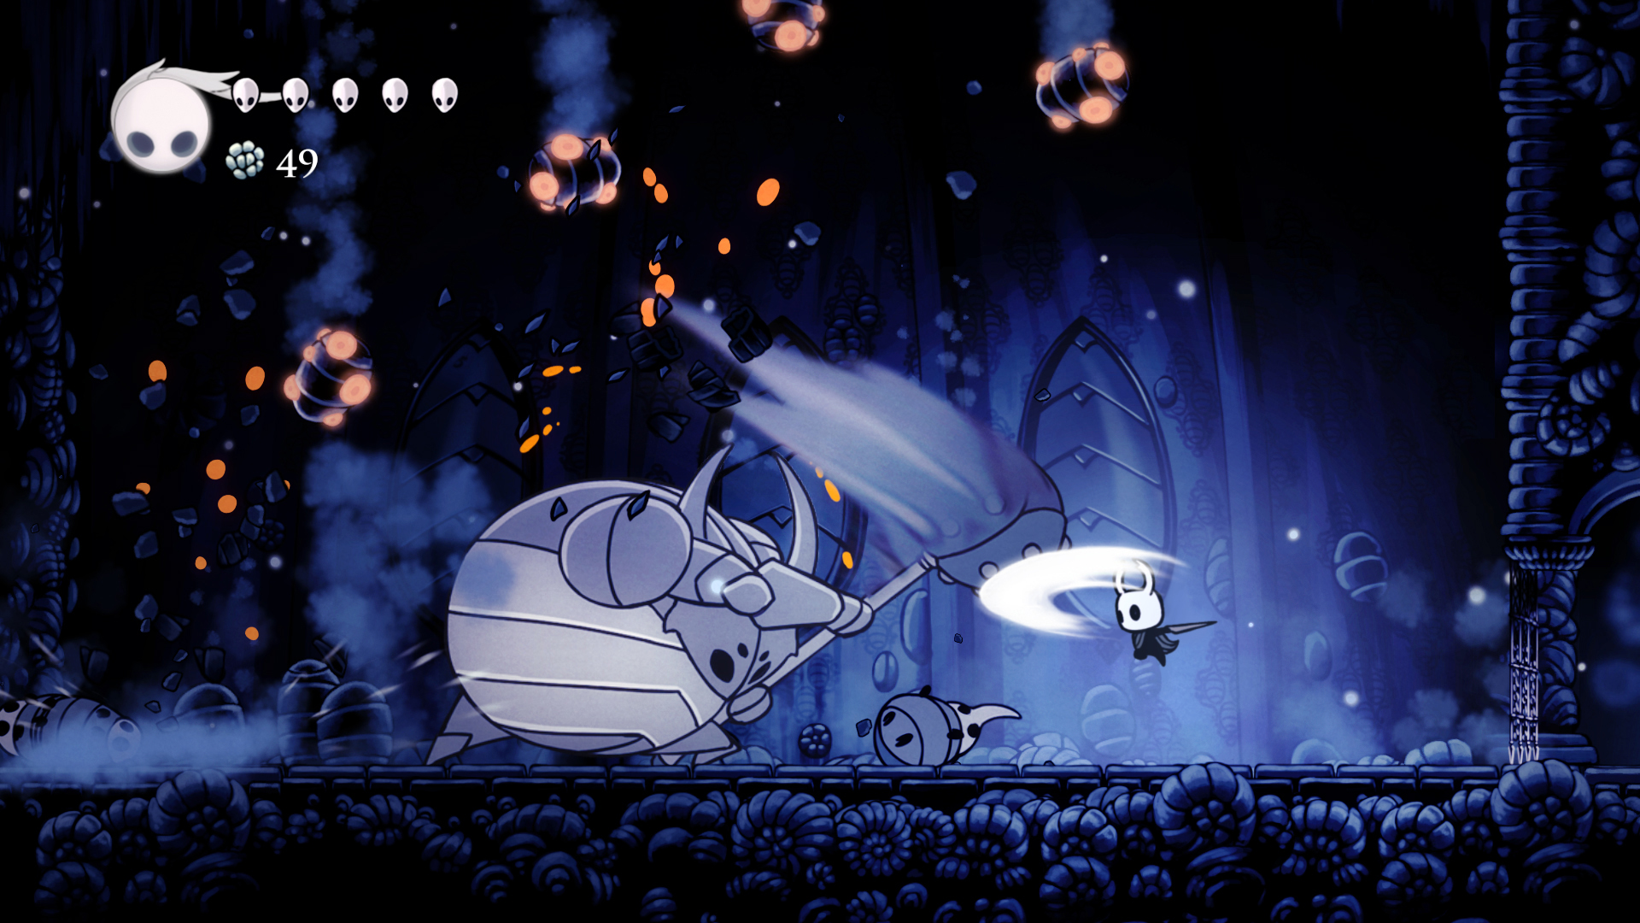
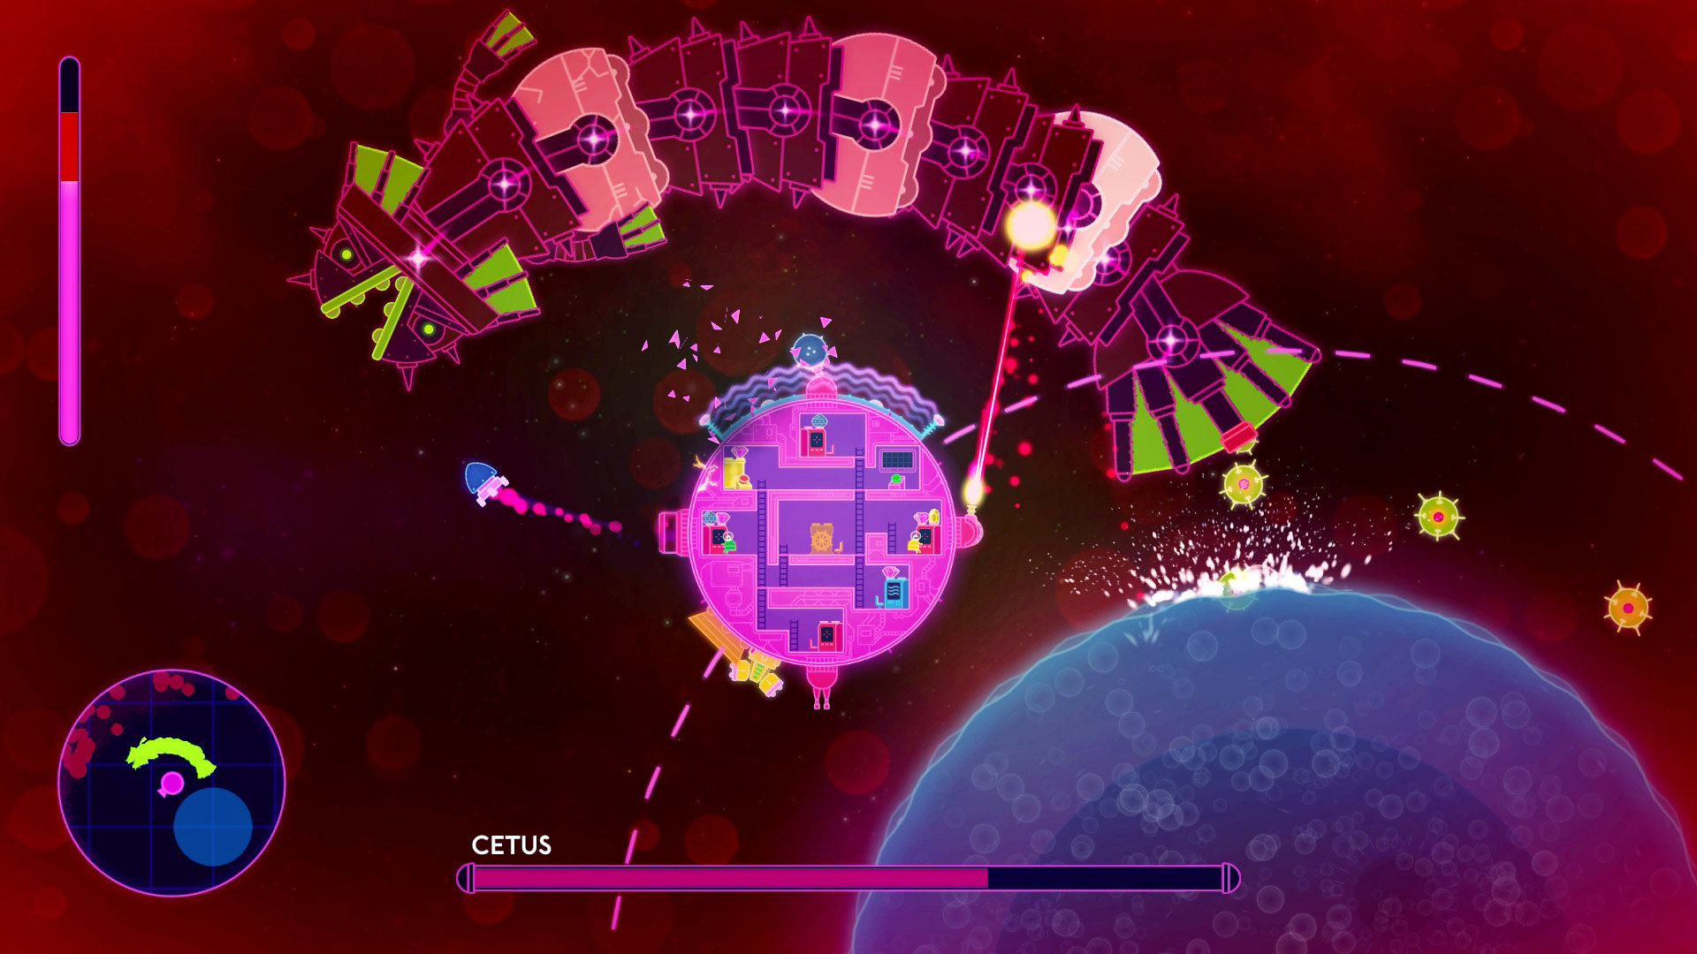

Games made in Unity

Slide 4
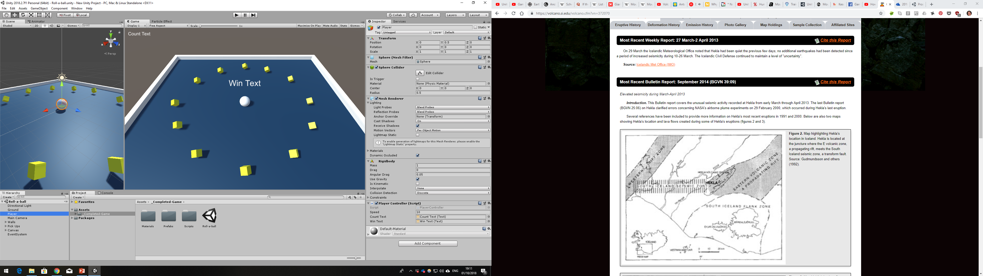
Unity Editor main interface
Game View
Layout
Object Manipulators
Scene View
Inspector Window
Hierarchy
Window
Project Window

Slide 5
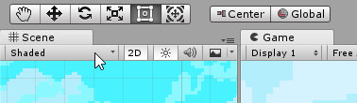
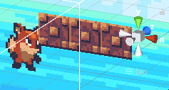
Setting up the main windows
The Unity interface can be configured in many ways.
Every tab can be dragged and docked where you want.
Tabs can be added or removed using the View menu.
The Layout button tells you what mode you are currently in.
choices are 2 by 3, 4 Split, Tall and Wide
You may want to use Wide when working generally and 4 Split for 3D level creation.
You can also make and save custom layouts (highly recommended).
The 4 Split mode is used when you need precise positioning
the standard orthographic method of top, side, front and 3D view can be setup from this
note: you can click on the Scene Gizmo in the top right of all scene windows to flip to a particular axis or to change between isometric and perspective projection modes.
You can make extensions to the Editor to add your own editor tools!
there are some really useful ones on the marketplace and many are free!
you can even sell your own tools, projects and assets here!
Scene Gizmo

Slide 6
The Scene View
The Scene is where you place GameObjects which will act as in-game objects (UE4’s Actors).
You can think of the Scene as showing you a level in the game you are making
every level in a game is usually created as a single scene but can be composed of several (useful!).
the Scene View is like the Viewport in UE4.
GameObjects are in-game entities that perform some activity.
could be represented as 3D models, sprites, sound sources, data managers, GUI elements and many others…
When you place a GameObject in the Scene, you can manipulate its world position, rotation and scale either by using the Object Manipulators or from within the Inspector tab (more later).
A word of warning!
The world axes used by Unity in 3D mode are different from those used in the Unreal Engine.
X-axis is left/right
Y-axis is up/down
Z-axis is forward/backward
Is there a benefit to this?
only so far as switching between 2D and 3D
in Unity, the y-axis is always the vertical axis regardless

Slide 7
The Hierarchy Window
You can make basic objects from the GameObject menu
GameObjects are equivalent to Actors in the Unreal Engine.
You will notice that as you add objects to the scene, they are also added to the Hierarchy.
The Hierarchy is not just a list of GameObjects present in the scene, it also shows the relationship between objects in the scene
these are known as parent-child relationships.
If you make a GameObject a child of another GameObject then it is bound to it and inherits it’s parent’s position, rotation and scale
this is handy for making composite GameObjects and allowing for relative movement / rotation.
You can establish a parent-child relationship by simply dragging-and-dropping a GameObject in the Hierarchy onto another GameObject
you can also break a parent-child relationship by dragging-and-dropping a child GameObject back into the root of the Hierarchy or onto another GameObject
you can, of course, also make or break this relationship in script
The Hierarchy is equivalent to the Scene/World Outliner in UE4.
Note: the Hierarchy also updates its list of GameObjects dynamically as the game is running.

Slide 8
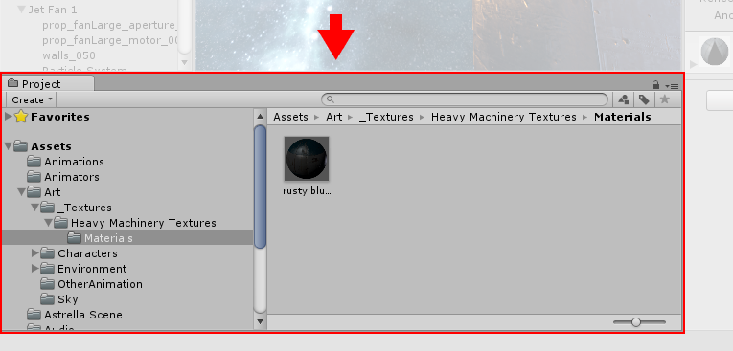
The Project Window
The Project Window is the same as the Content Browser in UE4.
When you create a project in Unity, a folder called Assets is made for you.
This folder holds all assets (3D models, textures, scripts, sound fx etc.) within it.
To use an asset in a scene, you must first either add it or create it within the Project tab.
You can either right-click within it to get a list of possible assets to create or use the tab’s Create button, alternatively, simple drag an asset into the folder from within the operating system.
Once an asset exists in the Project tab, you can drag it into the Scene or, in the case of scripts, either drag one onto a chosen GameObject or into that GameObject’s Inspector view.

Slide 9
The Inspector Window
Unity uses a component-based model.
All GameObjects are formed from a list of components where each component adds additional game engine behaviour to its host GameObject.
This could be an in-built game engine feature such as a Collider, Rigidbody, Controller etc. or a user-defined behaviour built using script.
A game is simply an interacting set of GameObjects.
The Inspector tab allows you to see what components are attached to a particular GameObject.
In UE4, the Inspector is known as the Details Panel.

Slide 10
The Inspector Window
The Inspector also lets you see and change any ‘visible’ attributes held by the various components
attributes are simply bits of data: numbers, strings, colours, textures etc.
more on this next week!
When a game is running from within the editor, you can change the values stored in the attributes on-the-fly to see the effect in-game
very useful when you want to try something out quickly (e.g. a character’s speed, number of lives etc.)!
note: the attributes will return to their original values when the game is stopped
Important: all GameObjects have one component called the Transform which holds information on:
the position of the object in the Scene
its rotation (local and world)
its scale
it also holds the parent-child relationships of the GameObject
This is the same as UE4 with some minor differences…

Slide 11
Moving around the scene view
Many options for movement!
none of them quite as good as UE4 sadly...
Moving using the hand tool (shortcut Q)
You can drag using the left mouse button
You can pivot using the right mouse button
You can orbit by holding the Alt key down and using the left mouse button
You can zoom by either scrolling with the mouse wheel (but there are issues) or by holding the Alt key down and using the right mouse button

Slide 12
Other movement
You can zoom to a selected object by first selecting the object in either the scene view or from the list in the Hierarchy window.
You can also walk through the scene using the arrow keys (hold down the Shift key to move faster).
You can move a selected object by using the drag tool (shortcut W).
You can rotate a selected object by using the rotate tool (shortcut E).
You can scale a selected object using the zoom tool (shortcut R).
You can use 'Flythrough Mode' by holding down the right mouse button and using WASD (hold down Shift for speed)
this is likely to be your preferred mode for moving around in the scene.
Q and E keys move up and down in this mode

Slide 13
Positioning objects within the scene
Select the drag tool, then the object (or vice versa).
You can now move it using the arrow gizmo on screen.
You have the option to move it using local or global draggers
if you move it on global drag mode, the draggers orient to the world co-ordinates
if you move it in local drag mode, the draggers orient to the object's rotational axes
You can move it by dragging just using the mouse but this will move the object according to the view of the scene.
If you want to position an object directly onto the scene, hold down Shift and Ctrl and left click and hold the centre of the object, then move it down.
There is a grid you can toggle the snapping for but it is less than ideal
we will show you ways to get a true grid snap and for 2D you can use the Tilemap system
Remember, if you need to position objects with great precision then consider switching your window layout to 4 Split.
You can then customise which windows in the split mode correspond to which desired view
e.g. Left, Front, Top, Perspective etc.

Slide 14
Let’s try this out…
Try adding simple 3D objects to the Scene.
Manipulate these objects (position, rotation, scale) either through the Object Manipulators or from within the Inspector.
Try creating parent-child relationships.
Now change the names of GameObjects either from within the Hierarchy or the Inspector tab.
What is a tag, what are they used for and how to make your own…
Let’s try something a bit more game-like.
On Blackboard, find the guide for building the basic Tilting Board framework.
I will quickly show you the steps on the board then you can try it out for yourselves.
When you’ve followed the tutorial, see what else you can add to this basic game
other blocks for obstacles, materials using textures you can get online, lights (spotlights etc.)

Slide 15
GameObjects and components
You are all aware now that a GameObject is anything that can be placed in a scene.
GameObjects contain a list of components that give them behaviours
Rigidbody allows the GameObject to work with the Physics system
Colliders allow for the detection of GameObjects hitting each other
a MeshRenderer draws a Mesh object to the screen
Etc.
UE4 typically follows the same naming conventions for these in-built components (e.g. Transform).
These components (and many more) are in-built behaviours scripted by Unity’s own developers.
You can define your own custom behaviour for a GameObject by making a new class and adding it as a component onto a GameObject.
We did this when we made a new class (called Tilt) to handle the tilting action for our board.
Note that a class in C# means the same thing as making a Blueprint in UE4.
The only difference is that in one you code your custom behaviours using a visual scripting system and in the other you use text – both have their advantages and disadvantages.

Slide 16
Engine events
A lot of gameplay is based on hooking up functions to engine events.
This could be functions that run when object’s collide, or a level loads, or a timer hits a value etc.
You are used to these from UE4:
InitializeComponent, BeginPlay, ActorBeginOverlap, Tick, Hit, Destroyed
Unity has much the same events, just maybe with different names:
Awake, Start, OnTriggerEnter, Update, OnCollisionEnter, OnDestroy
For GameObjects, these events are all defined in a class called MonoBehaviour
just like in UE4, you can also make your own custom events.

Slide 17
Generic Unity events / methods
Awake – used for obtaining references to other GameObjects or components
Start – used for initialising components
Update – is called by the engine per game tick
FixedUpdate – is called per physics engine tick
OnTriggerEnter – called when a GameObject intersects a trigger
OnTriggerStay – called per tick when a GameObject is inside a trigger
OnTriggerExit – called when a GameObject leaves a trigger
OnCollisionEnter – called when a physics-based GameObject collides with the GameObject
OnCollisionStay – called whilst a physics-based GameObject is touching a GameObject
OnCollisionExit – called when a physics-based GameObject stops touching a GameObject

Slide 18
Difference between Blueprints and C#
They do exactly the same thing!
They are there to define a component’s behaviour
data and functions (remember, events are functions too)
In UE4, you construct a function by chaining visual nodes together using execution pins.
These nodes are called in sequence following these execution lines.
Each node is a block of instructions that processes data in some desired fashion.
Functions can call other functions to perform complex tasks (either from within the same blueprint or one attached to another Actor in the level)
In C#, you make a method as a block of instructions.
Each instruction follows the next one line at a time.
Methods can call other methods to perform complex tasks (either from within the same class or one attached to another GameObject in the scene.

Slide 19
Complex GameObject behaviour
Each component attached to a GameObject adds some form of behaviour to it.
How much behaviour should go into one component?
Enough to make the component do one useful fully encapsulated behaviour that can potentially be reused on other GameObjects in this and maybe other projects.
This is called modularity.
To make GameObjects do complex things such as a fully animated 3D 3rd person controlled character that has an inventory, stats, quest log etc. you need components creating and attaching for each of these behaviours.
Let's start with a simple example for our Tilting Board.
We are going to go through the steps of making a teleporter.

Slide 20
Making a teleporter
If we want to make a teleporter to add to our tilting board, what do we do?
A teleport behaviour needs to be created via a class (whose name is up to us).
This class needs to define any required data and methods/functions to enable our teleporter to work.
So, what data does it need?
the exit point to ‘teleport’ the player’s ball to is obvious (could there be more?)
we need a function that will actual perform the required action
In UE4, you would:
make a new Actor-based Blueprint
make a new variable to hold an object reference (the Actor representing the position to teleport the ball to)
a function to change the position of the ball to that of the Actor stored in the variable
In Unity we:
make a new class (let’s call it Teleport)
within the class, make a new variable to hold a GameObject reference (our teleporter’s exit point)
use the in-built engine method OnTriggerEnter method to perform the position change

Slide 21
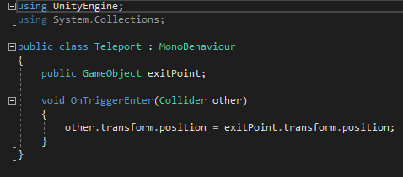
The Teleport class
This is called the class header
Any data goes here
Any methods go after the data
By making the variable public, we expose it to the Inspector Window.
This allows us to drag and drop a GameObject from the Hierarchy onto it.
The trigger method assigns the position of the exitPoint object to whatever collides with the trigger.
But what is the trigger?
Any GameObject that we add this new Teleport component to.

Slide 22
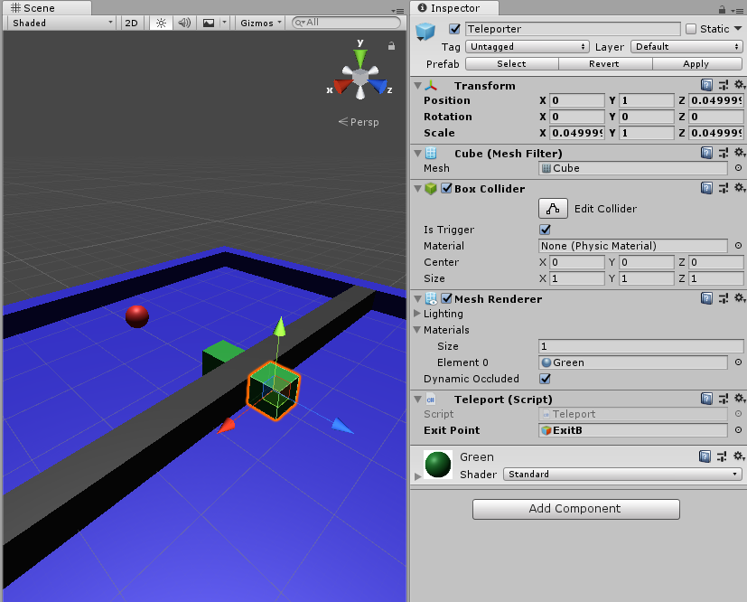
Teleporter GameObject
In this simple example, we make the teleporter out of a simple cube.
All GameObjects have a Transform component.
When you place a cube into the scene, it’s mesh filter contains the cube’s vertices.
By default, a cube GameObject also adds a Box Collider component to the object.
Colliders can be turned into a trigger by ticking the Is Trigger checkbox.
Renderer components draw the object.
This allows any attached script component to receive Trigger event messages and act upon them.
We can add in-built engine components or our own custom components to the GameObject by dragging and dropping them from the Project Window via the Inspector.

Slide 23
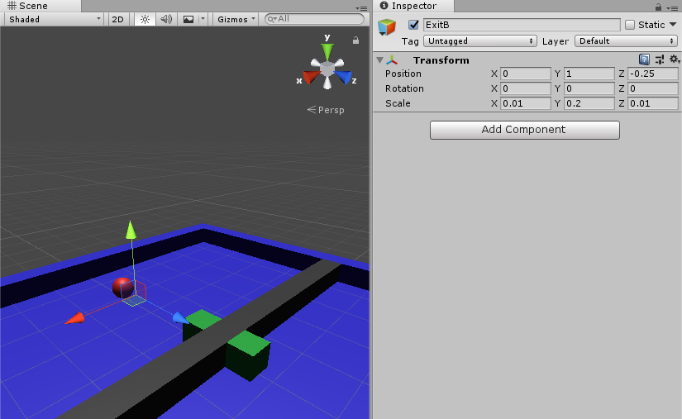
The teleporter’s exit point
So, we have a teleporter component.
This gives any GameObject it is attached to this type of behaviour.
This means that when any other GameObject intersects the teleporter’s mesh, it will be repositioned according to the OnTriggerEnter method.
But where is this?
We could have made data in the Teleport class to hold a location on the grid.
Our board base is moving though so we need a position relative to this base.
One way to do this is to place an empty GameObject in the scene and child it to the base so it moves with it.
We can then drag this object onto the exposed variable in the Teleport script for our teleporter.

Slide 24
Making prefabs
Of course, if you wanted to make lots of teleporters in your level, you could repeat the previous steps for each one.
A better approach is to make your complex GameObject (e.g. the teleporter) once in the Scene View and then turn it into a prefab.
This is an asset that is stored inside the Project Window.
To reuse the prefab inside your level, you can simple drag and drop it from the Project Window into the Scene.
any exposed variables can then be set to different values if desired
To turn your constructed GameObject into a prefab, simply drag it from either the Scene or the Hierarchy into an appropriate folder in the Assets area of the Project Window.
You can even place prefabs as child objects of prefabs.
Before version 2018.3, you will only see the first child inside the Project Window but as of 2018.3, fully nested prefabs can be viewed too.

Slide 25
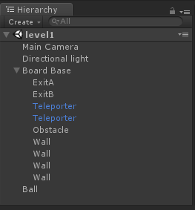
The Tilting Board with Teleporters Hierarchy
There’s a minimum of one camera in a level but there’s nothing stopping you having multiple.
The same is true of lighting and there are several types of light source, just as with UE4.
In this example, you can see that I have made the Board Base the parent of several other GameObjects.
There are two empty GameObjects representing the exit points of the teleporters.
Then I have the teleporters themselves (they are blue because that shows they are built from prefabs).
The other objects are stretched cubes which act as walls.
Finally, not parented to anything, I have the ball GameObject.

Slide 26
Teaching you to code behaviour in < 2 hours
Obviously, I can’t.
No-one can.
Just like when you built up some experience of creating Blueprints this last semester, there is much to learn and it never stops.
It is best to look at a few more examples of custom gameplay before taking the plunge at learning to code and use Unity further.
Have a look at the other examples and see how far your understanding goes.
Try changing some simple things, like values in variables or adding a new piece of gameplay to your existing project.
When you have done this, check out my short series of slides on the basics of C# coding and working with some standard engine events and components.
There are two more sets of slides you can have a look at and the tutorial material on the main Unity website is excellent!
Here’s Epic’s own guide on the differences between UE4 and Unity.

Slide 27
Tips
Make a custom assets/resources folder in your project.
Make a custom scripts folder in your project.
You may also want further sub–sections
levels, textures, materials, sound fx, music, models, sprites, shaders, Third Party, library etc.
Save often! Even though the engine is very stable, it usually takes seconds to do this so do it…
Keep previous versions of the project in case of corruption (zips with timestamps are good).
Even a simple project is many megabytes so you will need a USB memory stick or external hard-drive.
not a bad idea to zip projects and sync them to Dropbox, Google Drive etc.
Only import a package if you need it (and delete ones you don't use – same is true for UE).
Never move project assets around using the OS, you should use the project window always for this
although we've always found it to be fairly safe to do so…
You can duplicate project assets but its best not to do this with scripts (affects the meta-files).
You can also use a concurrent versioning system such as Git or SVN if you want but a better solution is to use the in-built Unity Collaborate system which is free for teams of up to three accounts.

